Slide 1



Interpreting the world on a
different plane
Robert Bosch Engineering and Business Solutions
AI/ML - Car and OEM Sales Forecast for Indian Market
(Predictive Analysis)
23/04/2018

Slide 2





Overview
Car and OEM Sales Forecast for Indian Market (Predictive Analysis)
TECHNOLOGIES
Build 6 months car and OEM Sales forecast using following input data
2 years of historical car sales
Fuel Price – Petrol and Diesel
GDP
Unemployment
BOSCH OEM Car Parts
The challenge is to accurately predict future Car and OEM Sales using predictive analytics and machine learning and then to identify the optimal strategy for OEM sales forecast.
Predictive Modeling and Data Visualization used to bring
Car Sales Forecast by make, segment and Fuel
BOSCH OEM Products Forecast
Identify the optimal strategy for BOSCH OEM Sales forecast.
2
RBEI/BSX | 2018
© Robert Bosch Engineering and Business Solutions Private Limited 2016. All rights reserved, also regarding any disposal, exploitation, reproduction, editing, distribution, as well as in the event of applications for industrial property rights.

Slide 3


Project Objective
Car and OEM Sales Forecast for Indian Market (Predictive Analysis)
MACHINE LEARNING MODELS
Models that are used are as follows:
Linear Regression
Logistic Regression
Random Forest
EXPLORING AND PRE PROCESSING DATA
Our data is divided into 70:30 ratio in training and testing data
VISUALIZING DATA
For Visualizing the data we used:
Bar graph
Point Graph
Line Graph
PREDICT CAR AND OEM SALES
For Predicting car sales we used four different models.
For Predicting OEM sales we multiplied the parts manufactured for particular car with total number of sales predicted.
3
RBEI/BSB | 2018
© Robert Bosch Engineering and Business Solutions Private Limited 2016. All rights reserved, also regarding any disposal, exploitation, reproduction, editing, distribution, as well as in the event of applications for industrial property rights.

Slide 4
(Predictive Analysis) Data Dictionary
Car and OEM Sales Forecast for Indian Market
Variable | Definition | Key (Sample)
make | Car manufacturer name.
model | Model name of the particular brand.
month_code | Code assigned to particular month.
total | Total Sale of the car for particular month.
gdp | Gross Domestic Platform of India for particular month.
unemployment | Unemployment rate of India for particular month
petrol_price | Petrol Price of India for particular month.
diesel_price | Diesel Price of India for particular month.
4
RBEI/BSB | 2018
© Robert Bosch Engineering and Business Solutions Private Limited 2016. All rights reserved, also regarding any disposal, exploitation, reproduction, editing, distribution, as well as in the event of applications for industrial property rights.

Slide 5
Data Dictionary
Car and OEM Sales Forecast for Indian Market
(Predictive Analysis)
Variable
diesel system | auxiliary system
breaking system | automotive bulbs
auto electricals | spark plugs
batteries | wiper blades
automotive belt | lightning coils
horns | charging coils
filters | ignition coils
gasoline system
5
RBEI/BSB | 2018
© Robert Bosch Engineering and Business Solutions Private Limited 2016. All rights reserved, also regarding any disposal, exploitation, reproduction, editing, distribution, as well as in the event of applications for industrial property rights.

Slide 6

Data Set Description
Car and OEM Sales Forecast for Indian Market(Predictive Analysis)
Dataset
2 Years Historic Data
Training and Test Data Set
19 Hundred Rows
8 Attributes
Deter mining the accuracy
6
RBEI/BSB | 2018
© Robert Bosch Engineering and Business Solutions Private Limited 2016. All rights reserved, also regarding any disposal, exploitation, reproduction, editing, distribution, as well as in the event of applications for industrial property rights.

Slide 7


Challenges
Car and OEM Sales Forecast for Indian Market (Predictive Analysis)
Car and OEM Sales Forecast has few challenges.
Dataset imbalance
Collecting data regarding car sales of previous two years monthly wise by considering each model of different companies.
Collection of data regarding various BOSCH OEM products of the organization used in different cars.
Mapping the OEM product sales with the prediction of car sales of a particular model.
Choosing of different algorithm for the prediction and comparing and getting best results out of all the models.
7
RBEI/BSB | 2018
© Robert Bosch Engineering and Business Solutions Private Limited 2016. All rights reserved, also regarding any disposal, exploitation, reproduction, editing, distribution, as well as in the event of applications for industrial property rights.

Slide 8
Use case - Car Manufacturers Based
Car and OEM Sales Forecast for Indian Market (Predictive Analysis)
Good Idea about the sales.
Profit for the company.
Knowledge about the popularity of the Car.
8
RBEI/BSB | 2018
© Robert Bosch Engineering and Business Solutions Private Limited 2016. All rights reserved, also regarding any disposal, exploitation, reproduction, editing, distribution, as well as in the event of applications for industrial property rights.

Slide 9
Use case - OEM Based
Car and OEM Sales Forecast for Indian Market (Predictive Analysis)
Fulfill the demands.
Ready with the supply.
Better utilization of man power.
9
RBEI/BSB | 2018
© Robert Bosch Engineering and Business Solutions Private Limited 2016. All rights reserved, also regarding any disposal, exploitation, reproduction, editing, distribution, as well as in the event of applications for industrial property rights.

Slide 10
Car and OEM Sales Forecast for Indian Market (Predictive Analysis)
Predictive modelling and Algorithms
10
RBEI/BSB | 2018
© Robert Bosch Engineering and Business Solutions Private Limited 2016. All rights reserved, also regarding any disposal, exploitation, reproduction, editing, distribution, as well as in the event of applications for industrial property rights.

Slide 11
Algorithms
Car and OEM Sales Forecast for Indian Market(Predictive Analysis)
Linear Regression
Random Forest
Algorithm Used
Logistic Regression
The Following supervised learning algorithms to perform data mining and statistic analysis in order to determine Car and OEM sales.
Here data set is in the form of structure .We should use supervised learning to deal with structural data.
11
RBEI/BSB | 2018
© Robert Bosch Engineering and Business Solutions Private Limited 2016. All rights reserved, also regarding any disposal, exploitation, reproduction, editing, distribution, as well as in the event of applications for industrial property rights.

Slide 12
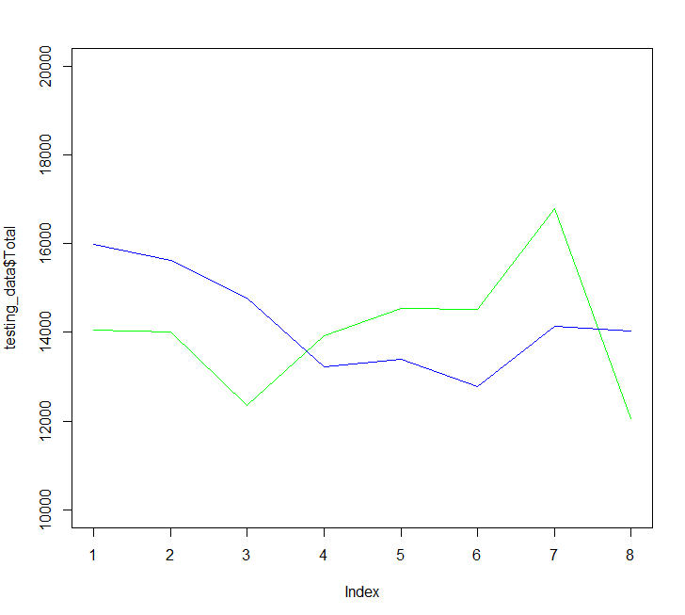
Linear Regression
Car and OEM Sales Forecast for Indian Market (Predictive Analysis)
Accuracy for Maruti Swift | RMSE value for Maruti Swift | Line Graph
Accuracy for Maruti Swift using Linear regression is: 83.33% | RMSE value for Maruti Suzuki Swift using Linear regression is : 1772
12
RBEI/BSB | 2018
© Robert Bosch Engineering and Business Solutions Private Limited 2016. All rights reserved, also regarding any disposal, exploitation, reproduction, editing, distribution, as well as in the event of applications for industrial property rights.

Slide 13
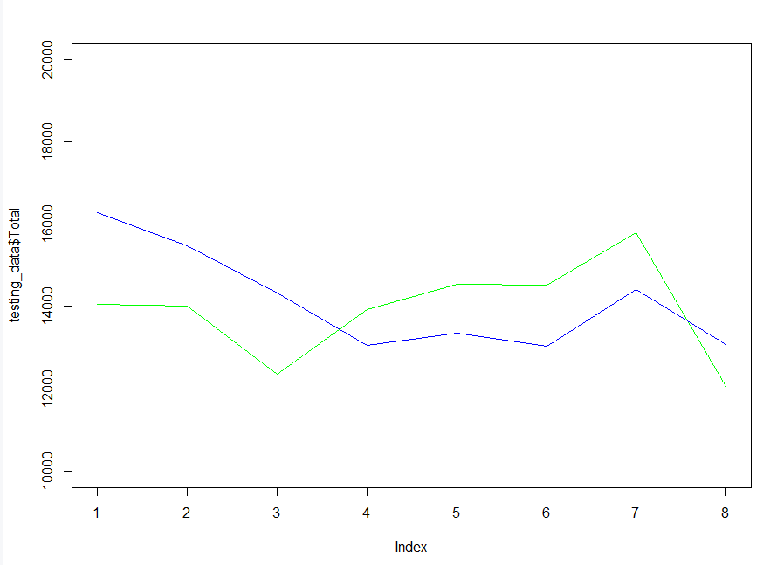
Logistic Regression
Car and OEM Sales Forecast for Indian Market (Predictive Analysis)
Accuracy for Maruti Swift | RMSE value for Maruti Swift | Line Graph
Accuracy for Maruti Swift using Linear regression is: 81.33% | RMSE value for Maruti Suzuki Swift using Linear regression is : 1820
13
RBEI/BSB | 2018
© Robert Bosch Engineering and Business Solutions Private Limited 2016. All rights reserved, also regarding any disposal, exploitation, reproduction, editing, distribution, as well as in the event of applications for industrial property rights.

Slide 14
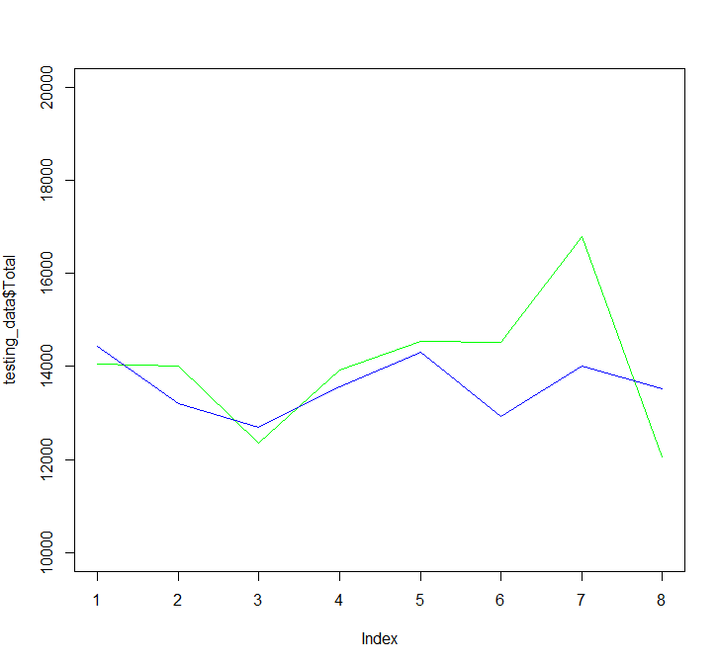
Random Forest
Car and OEM Sales Forecast for Indian Market (Predictive Analysis)
Accuracy for Maruti Swift | RMSE value for Maruti Swift | Line Graph
Accuracy for Maruti Swift using Linear regression is: 91.67% | RMSE value for Maruti Suzuki Swift using Linear regression is : 1300
14
RBEI/BSB | 2018
© Robert Bosch Engineering and Business Solutions Private Limited 2016. All rights reserved, also regarding any disposal, exploitation, reproduction, editing, distribution, as well as in the event of applications for industrial property rights.

Slide 15
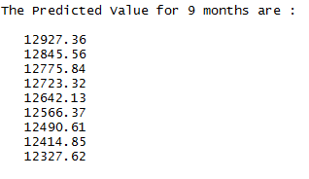
Car Sales Prediction
Car and OEM Sales Forecast for Indian Market (Predictive Analysis)
Car Sales Prediction using RANDOM FOREST for Maruti Swift for 9 months are
15
RBEI/BSB | 2018
© Robert Bosch Engineering and Business Solutions Private Limited 2016. All rights reserved, also regarding any disposal, exploitation, reproduction, editing, distribution, as well as in the event of applications for industrial property rights.

Slide 16
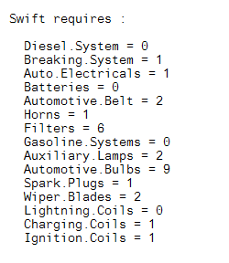
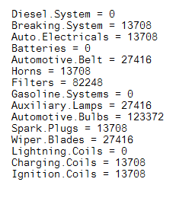
BOSCH OEM Sales
Car and OEM Sales Forecast for Indian Market (Predictive Analysis)
BOSCH OEM Car Parts used in Maruti Swift using RANDOM FOREST | Total BOSCH OEM Car Parts Required
16
RBEI/BSB | 2018
© Robert Bosch Engineering and Business Solutions Private Limited 2016. All rights reserved, also regarding any disposal, exploitation, reproduction, editing, distribution, as well as in the event of applications for industrial property rights.

Slide 17


ML Use case - 3
Interns @BSX : 2018
Car and OEM Sales Forecast for Indian Market (Predictive Analysis)
Team
Overview
Build 6 months car and OEM Sales forecast using following input data
2 years of historical car sales
Fuel Price : Petrol and Diesel
GDP
Unemployment
Different types of Prediction Methods and Data Visualization are used to bring
Car Sales Forecast by make, segment and Fuel
BOSCH OEM Products Forecast
Mentors
Ponvannan Ponnuramu (RBEI/BSW3)
Yuvaraj Vellore Chandrasekaran (RBEI/BSW3)
Interns
Ankit Parichha
Shobhit Sinha
Gaurav Kumar
Harshit Srivastava
Technologies
R Language for Predictive Analysis
Azure SQL DB or CSV file to Store data
Azure ML Studio to host and Deploy
17
RBEI/BSX | 2018
© Robert Bosch Engineering and Business Solutions Private Limited 2016. All rights reserved, also regarding any disposal, exploitation, reproduction, editing, distribution, as well as in the event of applications for industrial property rights.

Slide 18
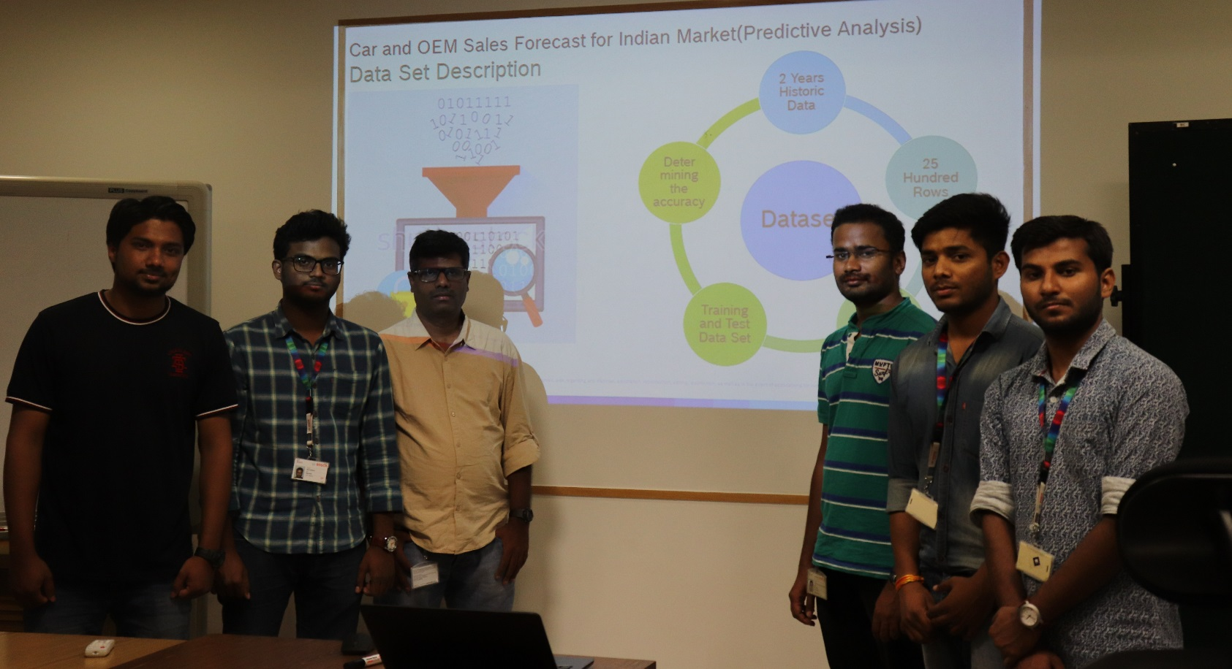
Picture Here
Team
Interns
Shobhit Sinha
Ankit Parichha
Gaurav Kumar
Harshit Srivastava
Mentors
Ponvannan Ponnuramu
Yuvaraj Vellore Chandrasekaran
18
RBEI/BSB | 2018
© Robert Bosch Engineering and Business Solutions Private Limited 2016. All rights reserved, also regarding any disposal, exploitation, reproduction, editing, distribution, as well as in the event of applications for industrial property rights.

Slide 19

Happy Machine Learning dANKE(THANK YOU)

